Slide 1
Classification Algorithms –
Regression & Knn

Slide 2
Outline
Linear Models (Regression)
Instance-based (Nearest-neighbor)

Slide 3


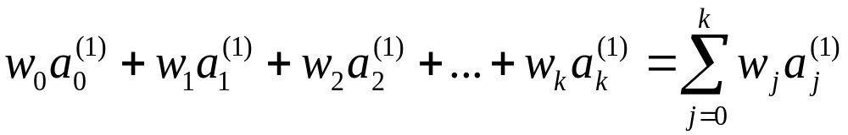
Linear models
Work most naturally with numeric attributes
Standard technique for numeric prediction: linear regression
  Outcome is linear combination of attributes
Weights are calculated from the training data
Predicted value for first training instance a⁽¹⁾

Slide 4
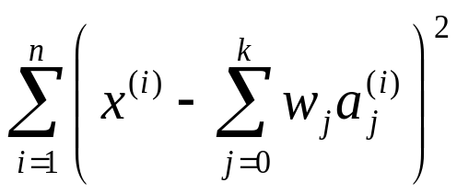
Minimizing the squared error
Choose k +1 coefficients to minimize the squared error on the training data
Squared error:
Derive coefficients using standard matrix operations
Can be done if there are more instances than attributes (roughly speaking)
Minimizing the absolute error is more difficult

Slide 5
Regression for Classification
Any regression technique can be used for classification
  Training: perform a regression for each class, setting the output to 1 for training instances that belong to class, and 0 for those that don’t
  Prediction: predict class corresponding to model with largest output value (membership value)
For linear regression this is known as multi-response linear regression

Slide 6

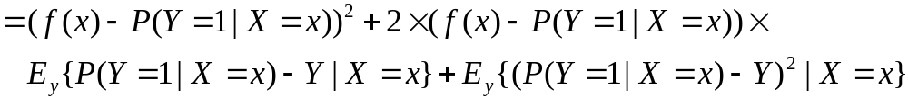
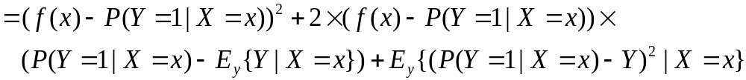
*Theoretical justification
Observed target value (either 0 or 1)
Model
Instance
The scheme minimizes this
True class probability
We want to minimize this
Constant
witten&eibe

Slide 7
*Pairwise regression
Another way of using regression for classification:
  A regression function for every pair of classes, using only instances from these two classes
  Assign output of +1 to one member of the pair, –1 to the other
Prediction is done by voting
  Class that receives most votes is predicted
  Alternative: “don’t know” if there is no agreement
More likely to be accurate but more expensive

Slide 8
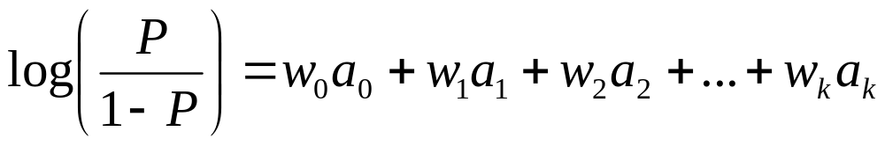
Logistic regression
Problem: some assumptions violated when linear regression is applied to classification problems
Logistic regression: alternative to linear regression
  Designed for classification problems
  Tries to estimate class probabilities directly
    Does this using the maximum likelihood method
  Uses this linear model:
P= Class probability

Slide 9
Discussion of linear models
Not appropriate if data exhibits non-linear dependencies
But: can serve as building blocks for more complex schemes (i.e. model trees)
Example: multi-response linear regression defines a hyperplane for any two given classes:

Slide 10
Comments on basic methods
Minsky and Papert (1969) showed that linear classifiers have limitations, e.g. can’t learn XOR
  But: combinations of them can (→ Neural Nets)

Slide 11
Outline
Linear Models (Regression)
Instance-based (Nearest-neighbor)

Slide 12
Instance-based representation
Simplest form of learning: vote learning
  Training instances are searched for instance that most closely resembles new instance
  The instances themselves represent the knowledge
  Also called instance-based learning
Similarity function defines what’s “learned”
Instance-based learning is lazy learning
Methods:
  nearest-neighbor
  k-nearest-neighbor
  …

Slide 13
The distance function
Simplest case: one numeric attribute
  Distance is the difference between the two attribute values involved (or a function thereof)
Several numeric attributes: normally, Euclidean distance is used and attributes are normalized
Nominal attributes: distance is set to 1 if values are different, 0 if they are equal
Are all attributes equally important?
  Weighting the attributes might be necessary

Slide 14
Instance-based learning
Distance function defines what’s learned
Most instance-based schemes use Euclidean distance:
a⁽¹⁾ and a⁽²⁾: two instances with k attributes
Taking the square root is not required when comparing distances
Other popular metric: city-block (Manhattan) metric
  Adds differences without squaring them

Slide 15
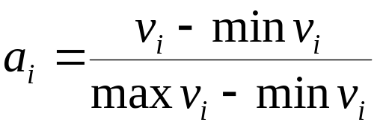
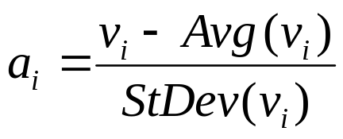
Normalization and other issues
Different attributes are measured on different scales ⇒ need to be normalized:
v_{i} : the actual value of attribute i
Nominal attributes: distance either 0 or 1
Common policy for missing values: assumed to be maximally distant (given normalized attributes)
or

Slide 16
Discussion of 1-NN
Often very accurate
… but slow:
  simple version scans entire training data to derive a prediction
Assumes all attributes are equally important
  Remedy: attribute selection or weights
Possible remedies against noisy instances:
  Take a majority vote over the k nearest neighbors
  Removing noisy instances from dataset (difficult!)
Statisticians have used k-NN since early 1950s
  If n → ∞ and k/n → 0, error approaches minimum

Slide 17
Summary
Simple methods frequently work well
  robust against noise, errors
Advanced methods, if properly used, can improve on simple methods
No method is universally best

Slide 18
Exploring simple ML schemes with WEKA
1R (evaluate on training set)
  Weather data (nominal)
  Weather data (numeric) B=3 (and B=1)
Naïve Bayes: same datasets
J4.8 (and visualize tree)
  Weather data (nominal)
PRISM: Contact lens data
Linear regression: CPU data

